Slide 1
Relocation Finder
James Wrenn

Slide 2
Prediction similar Location when Relocating
When people need to relocate they want to be able to find location near to their new place of work that share similarities with where they currently live.
The factors that have been used to categories similarity are:
Crime rates
Average income
Local amenities
Number of household / population

Slide 3
Business Problem
A chain of popular estate agents, within the UK, is looking for a USP to bring into their brand. There is currently saturation in the market for estate agents and they feel that they need to stand out if they are to prosper.
We need to be able to recommend areas that are simular to the clients current location, so that we can focus where to search. We would like to run a POC only using data for Hertfordshire and Cambridgeshire

Slide 4
Data acquisition and cleaning
Data was obtained from:
www.doogal.co.uk - postcodes, population sizes and LSOAs
www.data.police.uk – all crime data for last 9 months
Foursquare API – All amenity data
All unwanted data was stripped and remaining data was reshaped for analysis and merging.

Slide 5
Methodology
Load and transform data
Use Foursquare API to find amenity information
Calculate number of clusters
Perform k-mean clustering algorithm to cluster data
Visualise clusters using Folium
Add input box for current postcode
Visualise all prospective locations

Slide 6
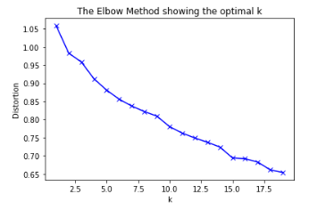
Analysis
K-Means elbow method was used to identify the optimal number of clusters
For the purposes of this project a K of 19 was used

Slide 7
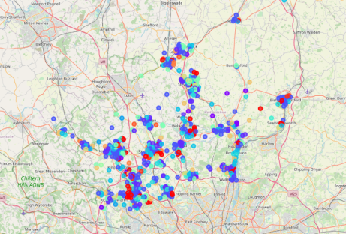
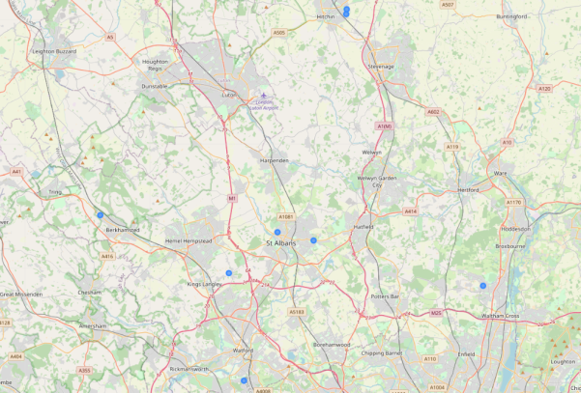
Results
All LSOAs clustered across the 2 counties
Using the sample postcode supplied 8 possible LSOAs where identified

Slide 8
Conclusion
Currently there is a acceptable level of accuracy. To gain more datasets are needed in order to make the clustering more accurate, these include:
Age ranges
Social demographic
Transport links
School ratings

